Slide 1
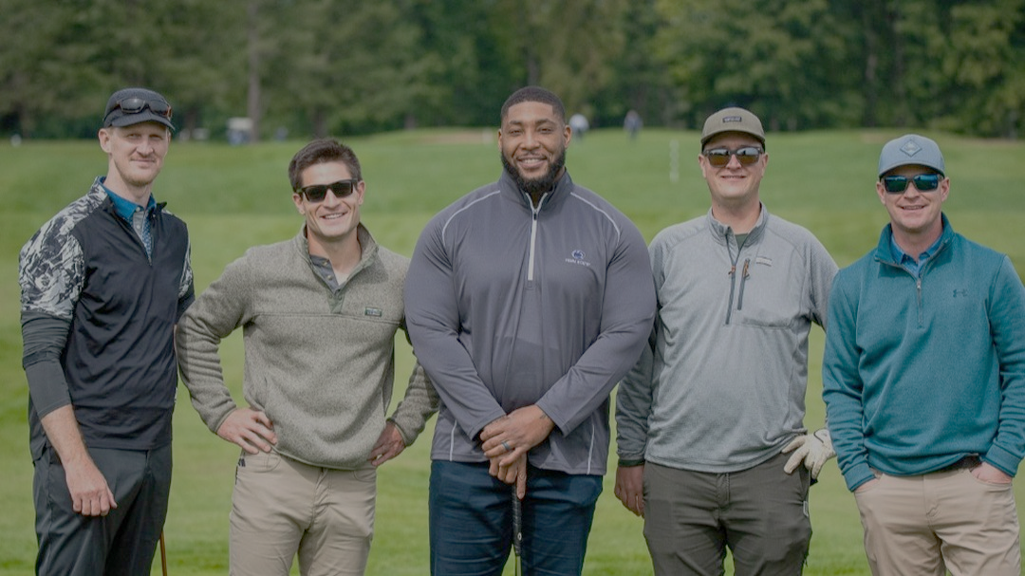
Still Strong Foundation
2025 Golf Tournament Sponsorship Opportunities

Slide 2

Everyday 43 Children are Diagnosed with Cancer
The financial burdens create a ripple effect into other parts of their family’s lives because the costs of treatment are so extreme
$833k
1 in 4
~40%
Beginning cost of childhood cancer treatment in the U.S.
Families reporting losing at least 40% of income because of treatment-related disruptions
Of families borrowed money for expenses, pushing them into debt
Source: The National Children’s Cancer Society, PubMed Central
Notes:
Stat option 1:
~60% of childhood cancer survivors experience severe or life threatening complications in adulthood
https://curesearch.org/childhood-cancer-statistics
Stat option 2
he cost of childhood cancer treatment is also high in the United States and begins at 833,000 United States Dollars (USD)
The National Children’s Cancer Society . The Economic Impact of Childhood Cancer. The National Children’s Cancer Society; St. Louis, MO, USA: 2018. [Google Scholar]
Stat option 3:
One in five children who receive a new diagnosis of childhood cancer are already living in poverty
https://www.childrenscancercause.org/blog/financial-resources#:~:text=One%20in%20five%20children%20who,medical%20care%20to%20save%20money.
Stat option 4
one in four families lose more than 40 percent of their annual household income as a result of childhood cancer treatment-related work disruption, while one in three families face other work disruptions such as having to quit work or change jobs.
(same link as 3)
Stat option 5
Thirty-eight percent of families have borrowed money from money lenders with an average interest rate of about 12.5% which pushes them to a state of debt for the next few years.
https://pmc.ncbi.nlm.nih.gov/articles/PMC5398105/

Slide 3
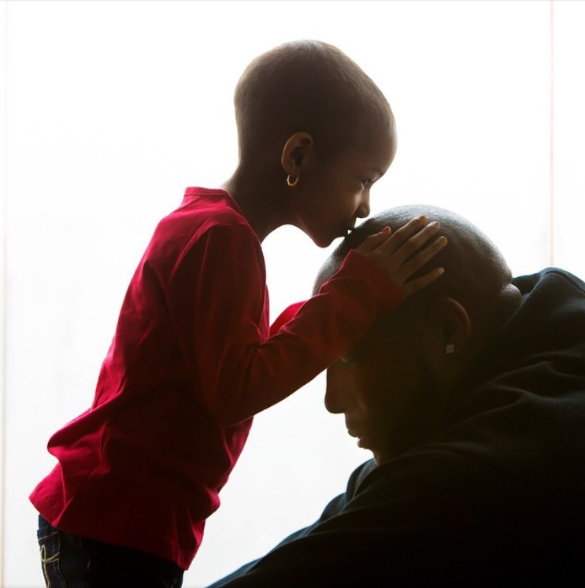
“Deciding between keeping the lights on or keeping watch over your sick child is not a choice any parent should face.”
Devon Still
Former NFL-er, ESPY Winner, and All American at Penn State

Slide 4
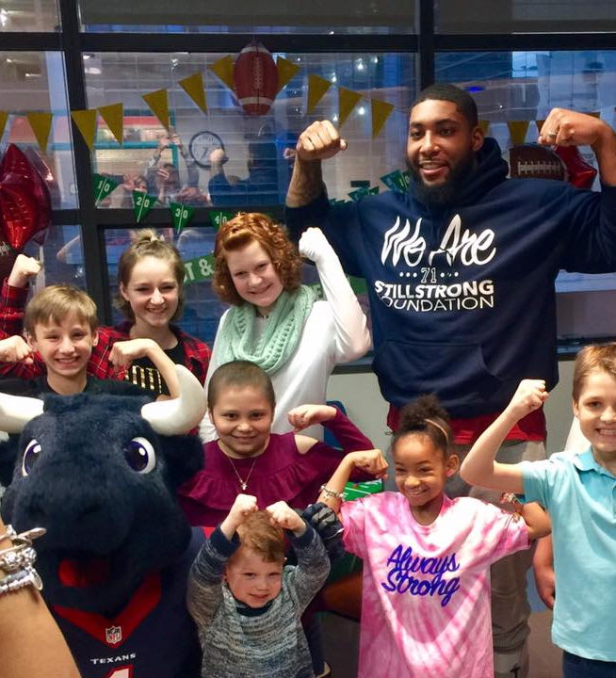
Still Strong Foundation
Our Mission
Founded by former pro-football player, Devon Still, the Still Strong Foundation is dedicated to supporting families and children battling cancer.
Our mission is to ensure families can focus on their child's recovery without the added stress of financial strain.
This vital support allows families to focus on what truly matters: their child’s health and recovery.

Slide 5
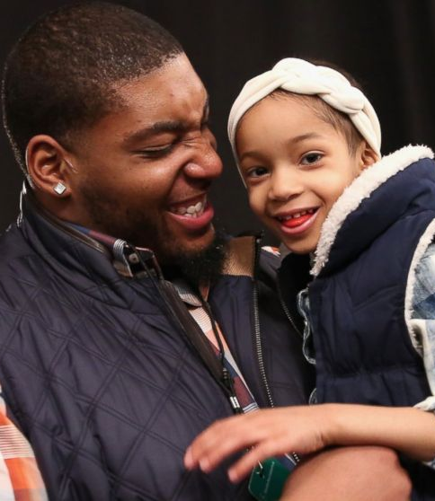





How We Help
Providing Essential Support Covering Non-Medical Expenses
Rent / Mortgage Payments
Utilities & Household Bills
Travel Expenses to Hospital
Childcare for Siblings
Car Payments

Slide 6
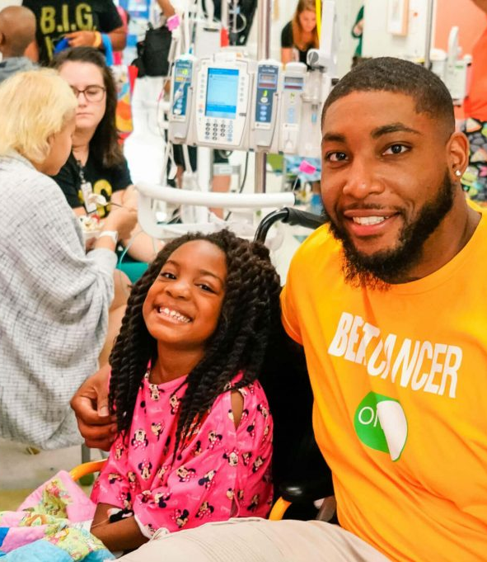






Affiliated with top pediatric oncology units to
Support Families Across the Country

Slide 7
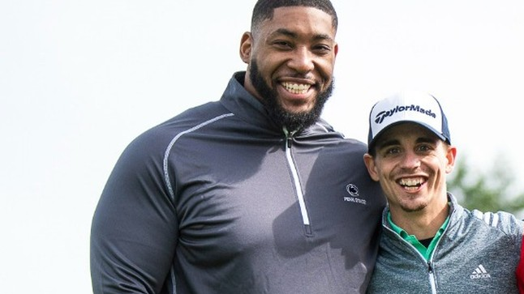
2025 Golf Tournament
Friday September 26th, 2025
Penn State Blue Course

Slide 8
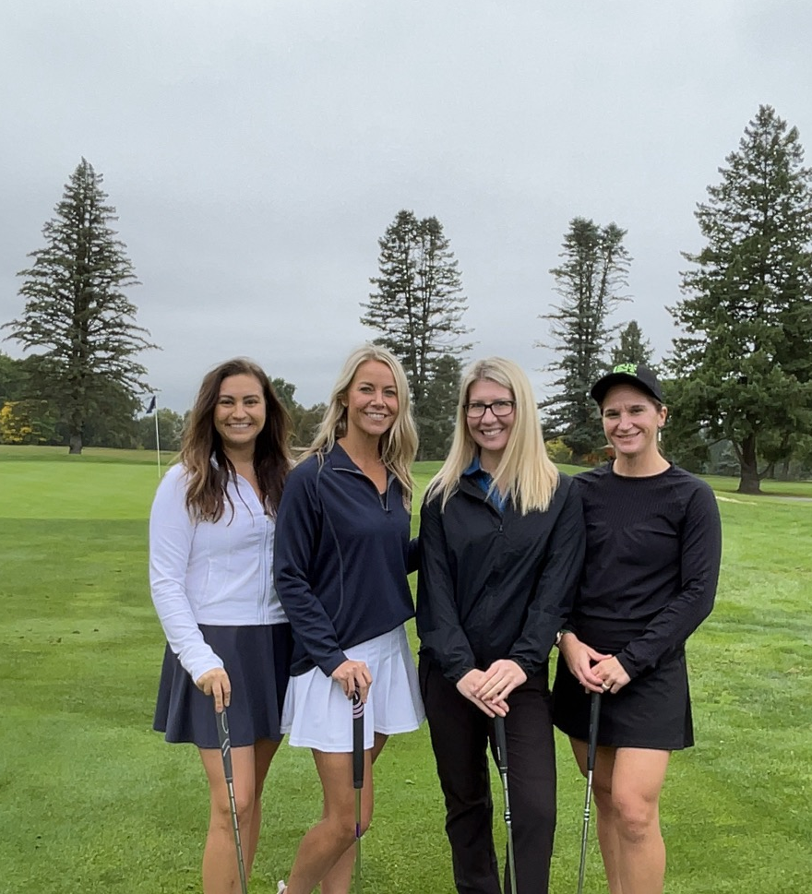
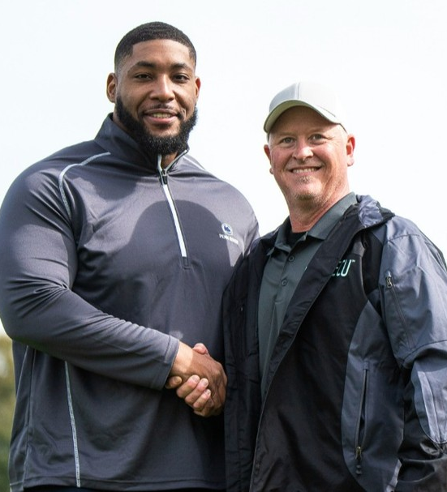
6th Annual Still Strong Foundation Golf Tournament
The Still Strong Foundation invites you to an unforgettable gameday weekend filled with excitement and purpose.
Our signature event series includes a meet & greet welcome reception and an exclusive golf tournament, all leading up to one of the biggest games of the season at Beaver Stadium.
Join us to make lasting connections, enjoy world-class events, and support a meaningful cause that changes lives.

Slide 9
Drive your business & support the cause
Sponsorship That Drives Brand Impact
Pairing cause marketing with a brand safe, social media star
77%
Of U.S. consumers are likely to buy/use products from brands who choose to help others when its needed most
7 in 10
U.S. consumers trust the recommendations from trusted social content creators
Source: NBCUniversal, Shopify
Notes:
Source1: NBCU Proprietary COVID-19 Studies, March-May 2020.
Source2: https://thesocialshepherd.com/blog/influencer-marketing-statistics / https://www.shopify.com/blog/influencer-marketing-statistics (Shopify)

Slide 10




Empowering Growth Across Your Business
Our premium marketing partnerships add powerful social media marketing to impactful CSR work
REACH
(Marketing & PR)
ENGAGE
(Corp Comms & Strategy)
COMMUNITY
(HR, CSR & Culture)
Your Brand
Branded Social Posts from Devon Still*
Corporate Appearance & Speaking Engagements
Tickets & Access to Still Strong Events
*1M Followers Across Platforms
Notes:
Stat option 1:
~60% of childhood cancer survivors experience severe or life threatening complications in adulthood
https://curesearch.org/childhood-cancer-statistics
Stat option 2
he cost of childhood cancer treatment is also high in the United States and begins at 833,000 United States Dollars (USD)
The National Children’s Cancer Society . The Economic Impact of Childhood Cancer. The National Children’s Cancer Society; St. Louis, MO, USA: 2018. [Google Scholar]
Stat option 3:
One in five children who receive a new diagnosis of childhood cancer are already living in poverty
https://www.childrenscancercause.org/blog/financial-resources#:~:text=One%20in%20five%20children%20who,medical%20care%20to%20save%20money.
Stat option 4
one in four families lose more than 40 percent of their annual household income as a result of childhood cancer treatment-related work disruption, while one in three families face other work disruptions such as having to quit work or change jobs.
(same link as 3)
Stat option 5
Thirty-eight percent of families have borrowed money from money lenders with an average interest rate of about 12.5% which pushes them to a state of debt for the next few years.
https://pmc.ncbi.nlm.nih.gov/articles/PMC5398105/

Slide 11
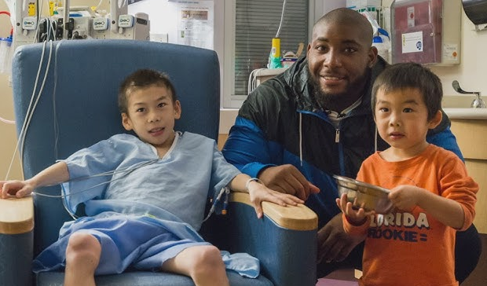
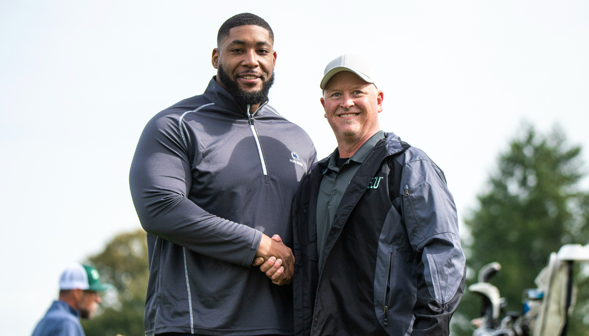
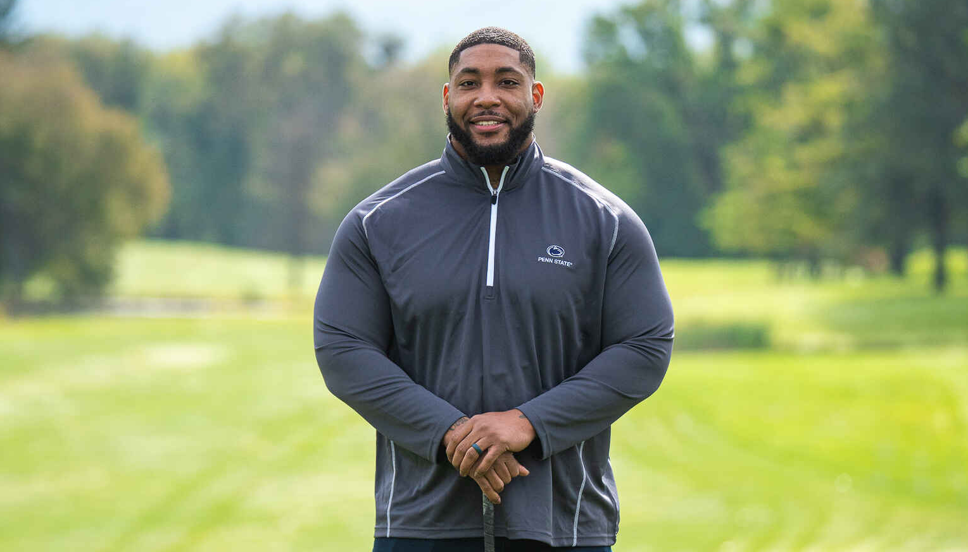
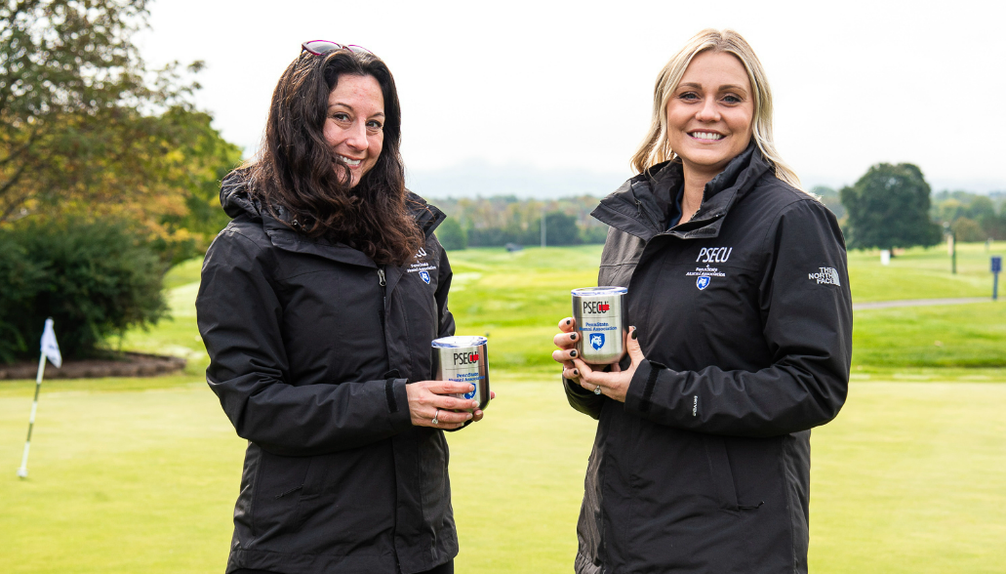
Premium Marketing Partnership Opportunities
Unlock unmatched social influencer and event marketing value for your business while supporting families in the fight of their lives
Entitlement Sponsor
3x branded social posts by Devon Still
1x keynote speech by Devon Still
4x foursomes and 16x VIP gifts
16x tickets to meet & greet reception
Brand integration on-site & online
Presenting Sponsor
2x branded social post by Devon Still
Name inclusion in sponsored event title
3x foursomes and 12x VIP gifts
12x tickets to meet & greet reception
Brand integration on-site & online
Hospitality Sponsor
1x branded social post by Devon Still
Sponsor of all food & beverage
2x foursomes and 8x VIP gifts
Brand integration on-site & online
$40,000 Donation
Value of $90,000
$20,000 Donation
Value of $45,000
$10,000 Donation
Value of $22,500
Notes:
Stat option 1:
~60% of childhood cancer survivors experience severe or life threatening complications in adulthood
https://curesearch.org/childhood-cancer-statistics
Stat option 2
he cost of childhood cancer treatment is also high in the United States and begins at 833,000 United States Dollars (USD)
The National Children’s Cancer Society . The Economic Impact of Childhood Cancer. The National Children’s Cancer Society; St. Louis, MO, USA: 2018. [Google Scholar]
Stat option 3:
One in five children who receive a new diagnosis of childhood cancer are already living in poverty
https://www.childrenscancercause.org/blog/financial-resources#:~:text=One%20in%20five%20children%20who,medical%20care%20to%20save%20money.
Stat option 4
one in four families lose more than 40 percent of their annual household income as a result of childhood cancer treatment-related work disruption, while one in three families face other work disruptions such as having to quit work or change jobs.
(same link as 3)
Stat option 5
Thirty-eight percent of families have borrowed money from money lenders with an average interest rate of about 12.5% which pushes them to a state of debt for the next few years.
https://pmc.ncbi.nlm.nih.gov/articles/PMC5398105/

Slide 12





Golf Tournament Sponsorship Opportunities
Turnkey event sponsorships that integrate your brand into a powerful community
Gift Sponsor
Corporate branding on gift bags
2x foursomes and 8x VIP gifts
8x tickets to meet & greet reception
Brand integration on-site & online
Contributing Sponsor
2x foursomes and 8x VIP gifts
8x tickets to meet & greet reception
Brand integration on-site & online
Beverage & Golf Cart Sponsor
Branding on all golf carts & koozies
1x foursome and 4x VIP gifts
4x tickets to meet & greet reception
Brand integration on-site & online
$5,000 Donation
$3,500 Donation
$2,500 Donation
Prize Sponsor
Prominent signage at prize table
1x foursome and 4x VIP gifts
4x tickets to meet & greet reception
Brand integration on-site & online
Driving Range Sponsor
Prominent signage at driving range
1x foursome and 4x VIP gifts
4x tickets to meet & greet reception
Brand integration on-site & online
Putting Green Sponsor
Prominent signage at driving range
1x foursome and 4x VIP gifts
4x tickets to meet & greet reception
Brand integration on-site & online
$2,500 Donation
$2,500 Donation
$2,500 Donation
Notes:
Stat option 1:
~60% of childhood cancer survivors experience severe or life threatening complications in adulthood
https://curesearch.org/childhood-cancer-statistics
Stat option 2
he cost of childhood cancer treatment is also high in the United States and begins at 833,000 United States Dollars (USD)
The National Children’s Cancer Society . The Economic Impact of Childhood Cancer. The National Children’s Cancer Society; St. Louis, MO, USA: 2018. [Google Scholar]
Stat option 3:
One in five children who receive a new diagnosis of childhood cancer are already living in poverty
https://www.childrenscancercause.org/blog/financial-resources#:~:text=One%20in%20five%20children%20who,medical%20care%20to%20save%20money.
Stat option 4
one in four families lose more than 40 percent of their annual household income as a result of childhood cancer treatment-related work disruption, while one in three families face other work disruptions such as having to quit work or change jobs.
(same link as 3)
Stat option 5
Thirty-eight percent of families have borrowed money from money lenders with an average interest rate of about 12.5% which pushes them to a state of debt for the next few years.
https://pmc.ncbi.nlm.nih.gov/articles/PMC5398105/

Slide 13
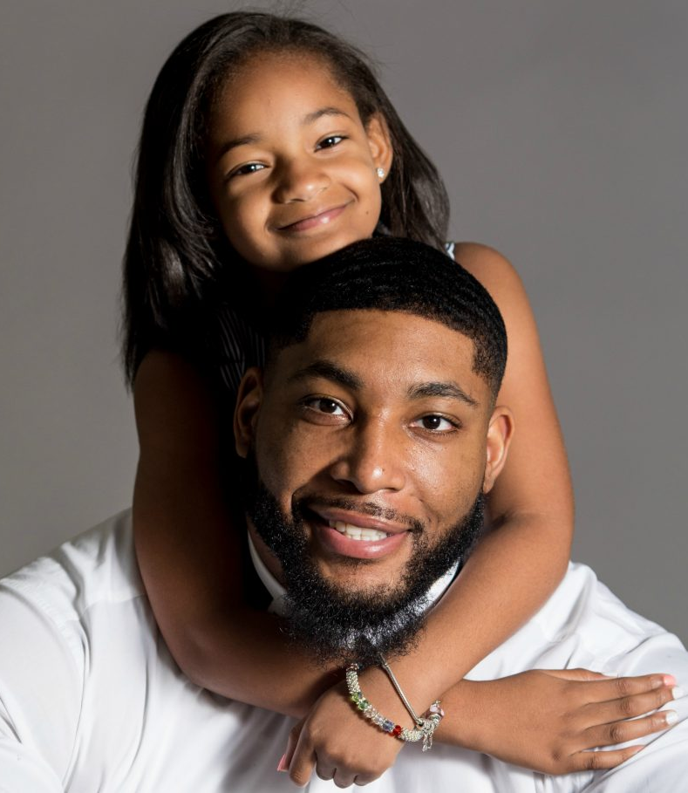




Partnership Benefits
Marketing with a Cause
Brand Safe Celebrity Alignment
Boost Your Brand’s Social Impact
Community Engaging Events
Unlocked by Tax Deductible Donation

Slide 14
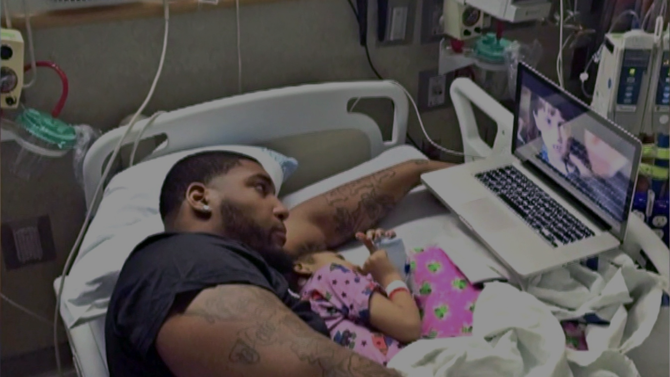
Join us in the fight against childhood cancer

